Slide 1
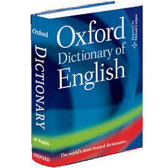
Dictionary/Tuples and Methods

Slide 2
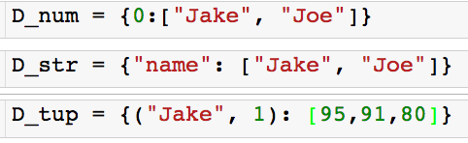
Dictionaries
Collection of unordered objects stored/accessed through keys
The key in a dictionary must me an immutable object
number, string, tuple, dictionary (we can have nested dictionaries)
The value can be any object

Slide 3
Dictionaries
The key in a dictionary must me an immutable object
number, string, tuple, dictionary (we can have nested dictionaries)
The value can be any object
Key (tuple)
Value (list)

Slide 4
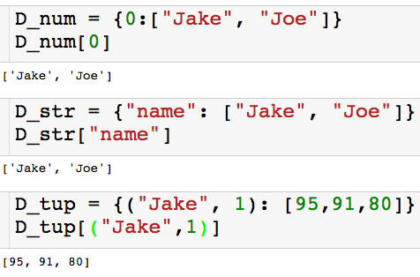
Dictionaries
The key in a dictionary must me an immutable object
number, string, tuple, dictionary (we can have nested dictionaries)
The value can be any object and it is access through its key

Slide 5
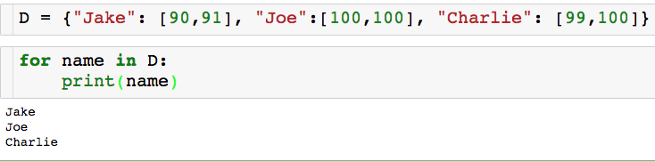
Dictionaries As Loop Target
Iterate over keys of dictionary:
REMEMBER: Dictionaries are not ordered!

Slide 6
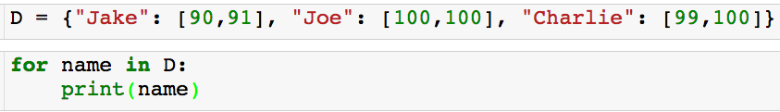
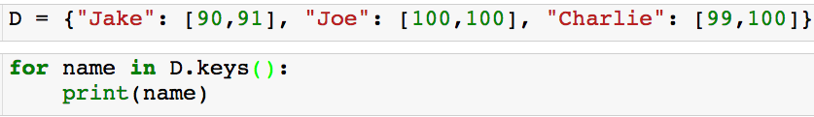
Dictionaries As Loop Target
Iterate over keys of dictionary:
REMEMBER: Dictionaries are not ordered!
Equivalent way to iterate over keys of dictionary:
More on this later

Slide 7
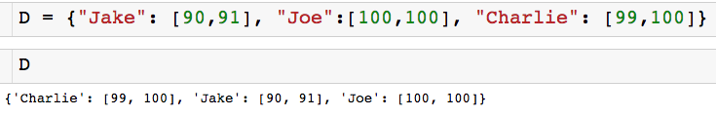

Add Element to Existing Dictionary
Name of dictionary we want to add to
New key
New value

Slide 8

Add Element to Existing Dictionary
Name of dictionary we want to add to
New key
New value

Slide 9


Why Dictionaries
Why Dictionaries?
Let’s us store and access info through something other than a number (index).
Let’s say I wanted to store people’s address somewhere in my code
With a dictionary:
With a list:

Slide 10

Why Dictionaries
With a dictionary:
Take get Joe’s address:

Slide 11
Why Dictionaries
With a list:
To get Joe’s address (imagine there were hundreds of addresses):

Slide 12
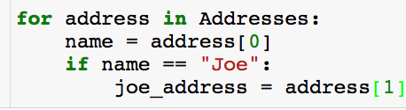
Why Dictionaries
With a list:
To get Joe’s address (imagine there were hundreds of addresses):
A lot more tedious!

Slide 13
Why Dictionaries
Let’s say I want to create a dictionary which stores the number of times each word appears in the list:

Slide 14
Why Dictionaries
Let’s say I want to create a dictionary which stores the number of times each word appears in the list:
How would you do this with just lists?

Slide 15
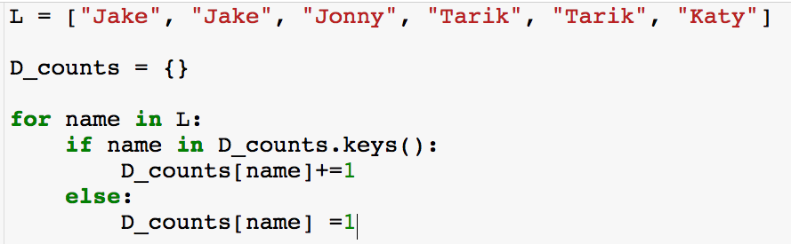
Why Dictionaries
Let’s say I want to create a dictionary which stores the number of times each word appears in the list:

Slide 16
Why Dictionaries
Let’s say I want to create a dictionary which stores the number of times each word appears in the list:

Slide 17
Why Dictionaries
Let’s say I want to create a dictionary which stores the number of times each word appears in the list:

Slide 18
Why Dictionaries
Let’s say I want to create a dictionary which stores the number of times each word appears in the list:

Slide 19
Why Dictionaries
Let’s say I want to create a dictionary which stores the number of times each word appears in the list:

Slide 20
Why Dictionaries
Let’s say I want to create a dictionary which stores the number of times each word appears in the list:

Slide 21
Why Dictionaries
Let’s say I want to create a dictionary which stores the number of times each word appears in the list:

Slide 22
Why Dictionaries
Let’s say I want to create a dictionary which stores the number of times each word appears in the list:

Slide 23
Why Dictionaries
Let’s say I want to create a dictionary which stores the number of times each word appears in the list:

Slide 24
Why Dictionaries
Let’s say I want to create a dictionary which stores the number of times each word appears in the list:

Slide 25
Why Dictionaries
Let’s say I want to create a dictionary which stores the number of times each word appears in the list:
And so on….

Slide 26

Why Dictionaries
Let’s say I want to compute each person’s score

Slide 27
Why Dictionaries
Let’s say I want to compute each person’s score
How would you do this with just lists?

Slide 28
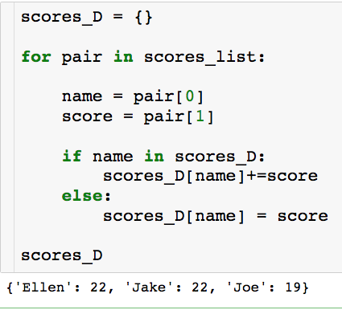
Why Dictionaries
Let’s say I want to compute each person’s score
With dictionary:

Slide 29
Why Dictionaries
Let’s say I want to compute each person’s score
With dictionary:
Unnecessary, but makes code more readable

Slide 30
Tuples
Tuples are essentially immutable lists.
They can be slice and index and used in for loops, but you can’t sort them.
Since they are immutable, they can be keys in a dictionary, as we already saw.

Slide 31
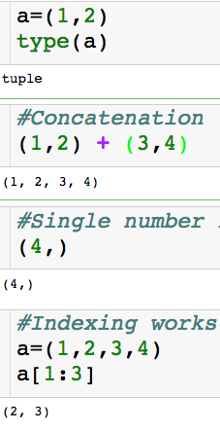
Tuples
Tuples are essentially immutable lists.
They can be slice and index and used in for loops, but you can’t sort them.
Since they are immutable, they can be keys in a dictionary, as we already saw.
Notice parentheses instead of bracket!

Slide 32
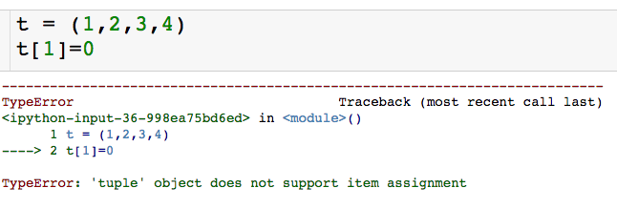
Tuples
Tuples are essentially immutable lists.
They can be slice and index and used in for loops, but you can’t sort them.
Since they are immutable, they can be keys in a dictionary, as we already saw.
Can’t change an element of tuple because of immutability

Slide 33
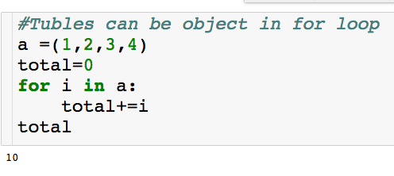
Tuples
Tuples are essentially immutable lists.
They can be slice and index and used in for loops, but you can’t sort them.
Since they are immutable, they can be keys in a dictionary, as we already saw.
Can be used in for loops!

Slide 34
Python Objects
Python objects are dynamically typed – when we create a variable we don’t have to say what type of object it will store.
Python objects are wither mutable (can be changed) or immutable (cannot be changed)
Python objects are strongly typed – there are built in type specific methods that help us manipulate objects.

Slide 35
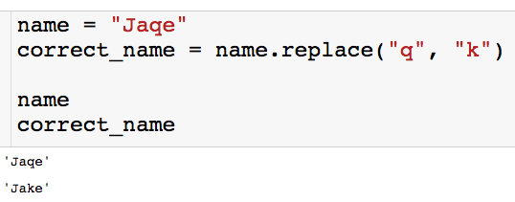
String Methods
Replace method : global search and replace.
name of string
method

Slide 36
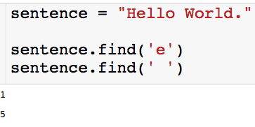
String Methods
Find method : finds the first location of the given substring (or a -1 if it is not found).

Slide 37
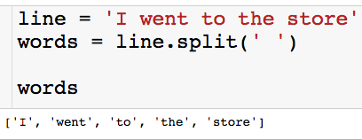
String Methods
Split method : splits string into list, delimited by input.
“split string by space”

Slide 38
String Methods
Split method : splits string into list, delimited by input
“split string by space”

Slide 39
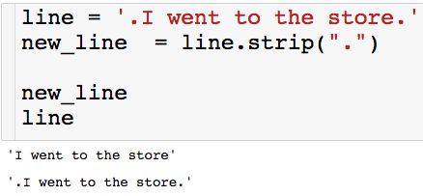
String Methods
Strip method : Deletes input from both sides of string.

Slide 40
String Methods
Strip method : Deletes input from both sides of string.
“Get rid of periods on the left and right of the string”

Slide 41
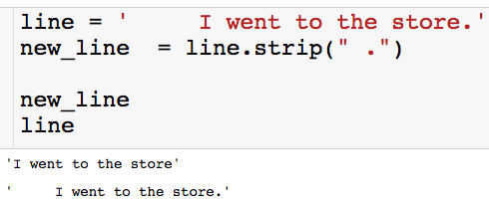
String Methods
Strip method : Deletes input from both sides of string.

Slide 42
String Methods
Strip method : Deletes input from both sides of string.
“Get rid of spaces and periods from the left and right of the string.”

Slide 43
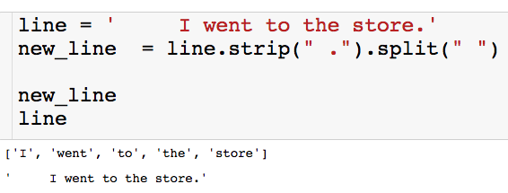
String Methods
We can stack string methods

Slide 44
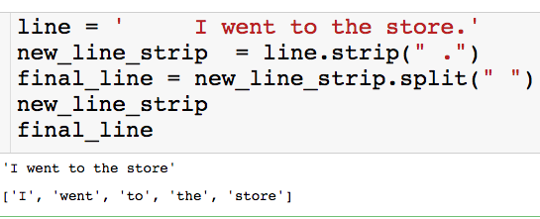
String Methods
We can stack methods

Slide 45
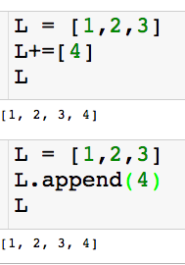
List Methods
Append method : Add element to end of the list.

Slide 46
List Methods
Append method : Add element to end of the list.
Since lists are mutable the methods change the object itself!

Slide 47
List Methods
Append method : Add element to end of the list.
Do these really do the same thing?
Since lists are mutable the methods change the object itself!

Slide 48
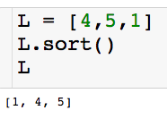
List Methods
Sort method : Sorts the elements in the list

Slide 49
List Methods
Sort method : Sorts the elements in the list
You will lose the original ordering of L in this case

Slide 50
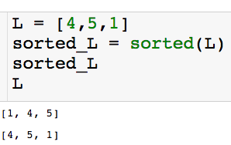
Built in Sort Function

Slide 51
Built in Sort Function
Unlike the sort() method, running the sorted function on L does not change L,
It just returns a sorted version of L that we can store!

Slide 52
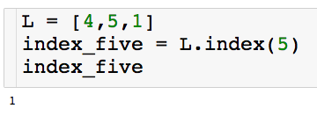
List Methods
Index method : returns the index of first occurrence of the inputted element.
If I want to use the index I have to store it....

Slide 53
List Methods
Index method : returns the index of first occurrence of the inputted element.
If I want to use the index I have to store it....
What happens if the list does not have the inputted element?

Slide 54
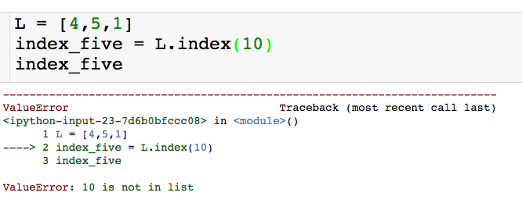
List Methods
Index method : returns the index of first occurrence of the inputted element.
We get an error!

Slide 55

Question
How do I find all indices of a given element?

Slide 56
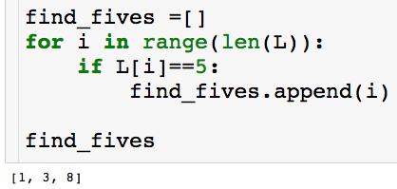
Question
How do I find all indices of a given element?
Answer 1: For loop

Slide 57
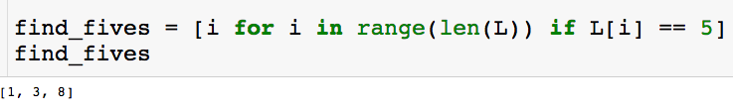
Question
How do I find all indices of a given element?
Answer 2: List comprehension (more on this later…)

Slide 58
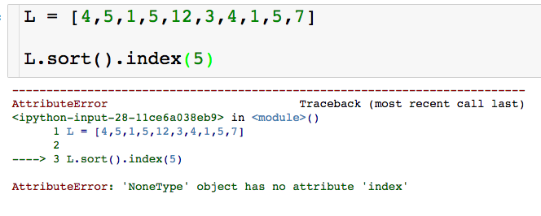
List Methods
We cannot stack list methods
This is because list methods do not return anything, they change the list inplace.

Slide 59
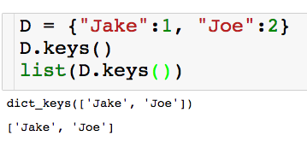
Dictionary Methods
keys method : returns the keys as an interable.
You can wrap in a list to a get indexable object

Slide 60
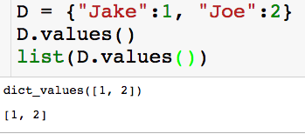
Dictionary Methods
values method : returns the values as an interable.
You can wrap in a list to a get indexable object

Slide 61
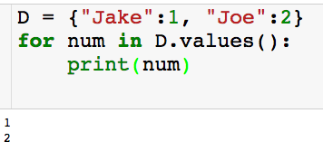
Dictionary Methods
values method : returns the values as an interable.
Can put values on object in four loop:

Slide 62
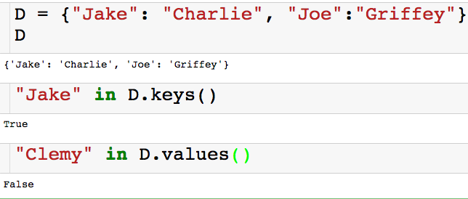
Dictionary Methods
We can check whether a key or value exists as follows:

Slide 63
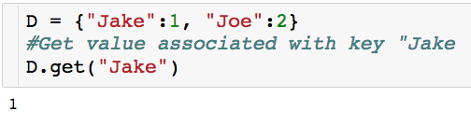
Dictionary Methods
get method : another way to access a value through a key

Slide 64
Dictionary Methods
get method : another way to access a value through a key
Main difference: Try to access key that does exist.

Slide 65
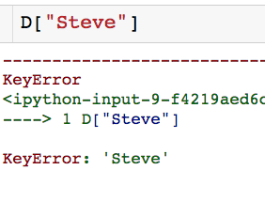
Dictionary Methods
get method : another way to access a value through a key
Main difference: Try to access key that does exist.

Slide 66

Dictionary Methods
get method : another way to access a value through a key
Main difference: Try to access key that does exist.
Won’t cause code to crash

